Slide 1
Session 2: CSS
We’ll be covering the basics of CSS:
What is CSS?
Anatomy of a CSS rule
Linking your CSS to HTML
Common properties
Different types of selectors
Cascading styles

Slide 2
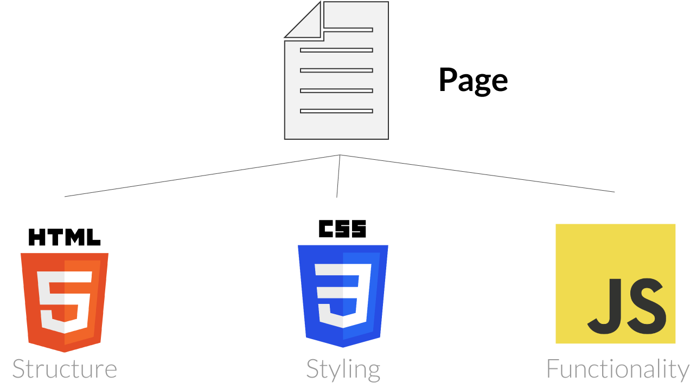
How are websites made?
Websites are built using three different components:
HTML
CSS
JavaScript
Person
Skeleton Appearance Behaviour, actions

Slide 3

What is CSS?
CSS stands for Cascading Style Sheets
CSS describes how HTML elements are displayed on screen and mobile devices
CSS can control the layout of multiple elements and multiple web pages all at once

Slide 4
Anatomy of a CSS rule
A CSS rule-set consists of a selector and a declaration block
Syntax
Example
selector
{
body
{
color
:
:
red
value
property
;
;
}
}

Slide 5
Anatomy of a CSS rule
A CSS rule-set consists of a selector and a declaration block
selector
{
:
value
property
;
:
value
property
;
}

Slide 6
Style locations
CSS can be placed in several different locations within your website.
Linked Style Sheet
Embedded Style
Inline Style
CSS file:
body {
background-color:white;
}
h1 {
color:blue;
}
HTML file:
<head>
<title>StylesDemo</title>
<style>
body { background-color: white; }
h1 { color: blue; }
</style>
</head>
<body style="background-color:white;">
<p style="color:blue;">This style is inline on the element.</p>
</body>
External style sheets
referenced by the <link> tag
Style situated in the <head> section on the web page
Style within the element itself

Slide 7
How is it used
How would we add font colour this h1 element?
HTML file:
CSS file:
<h1>Hello World</h1>
h1
{
color
:
red
;
}

Slide 8
Linking your CSS to HTML
Your index.html needs to know about your CSS file.
You need to add a link into your HTML file to reference your CSS file →
<!DOCTYPE html>
<html lang=”en”>
<head>
<link rel=”stylesheet” href=”./css/main.css” />
</head>
<body>
<h1>Welcome to my site!</h1>
</body>
</html>

Slide 9
Common properties
There are lots of properties out there and there is a lot you can change with them. You can always find more if you need them but let’s start with the most common ones:
Text color color: black;
Background colour background-color: white;
Font font-family: Arial;
Text decoration text-decoration: none;
→ underline | overline | line-through
Text align text-align: center;
→ left | right
CSS file:
h1 {
color: red
font-family: Arial;
}
You can find more properties here: https://www.w3schools.com/cssref/

Slide 10
Colours
It can happen that you might want to add a specific colour that you do not know the name of. There are a few ways to represent a colour:
Names
red, lightblue, tiel, chocolate, etc.
Most colour names you can think of are supported
RGB
Red Green Blue combination
Each colour is a number, 0-255, representing colour intensity
rgb(0,255,255) would create cyan colour as a mix of green and blue
Hexadecimal
Uses RGB principle but encodes those 3 numbers into 3 hexadecimals
#00ffff
Most popular way of representing colours
CSS file:
.cyanText {
color: cyan;
color: rgb(0, 255, 255);
color: #00ffff;
}
You do not need to know how to change numbers to hexadecimals. Use any colour picker tool online to do the job for you! For example this one: https://developer.mozilla.org/en-US/docs/Web/CSS/CSS_Colors/Color_picker_tool

Slide 11
Exercises
Exercise 1
Change the font of your page body to Arial.
Think of a primary and a secondary colour that compliment each other for your website. Now colour all of your anchor elements in your primary colour, and remove the default underline by using the text-decoration property.

Slide 12
Different types of selectors
Type & id selectors
Type selector uses the element name and will select all elements with that name.
CSS file:
h1 {
color: blue;
}
HTML file:
<h1> Welcome to my site!</h1>
Id selector will select an element based on the value of its id attribute. There should be only one element with a given ID in a document.
CSS file: #title-3 {
color: red;
}
HTML file:
<h1 id=”title-3” >Welcome to my site!</h1>

Slide 13
Different types of selectors
Class selector
Class selector uses the class name and will select all classes with that name.
CSS file:
.text-green {
color: green;
}
HTML file:
<h1 class= ”text-green” >Welcome to my site!</h1>
<p class= ”text-green” >Make yourself at home</p>

Slide 14
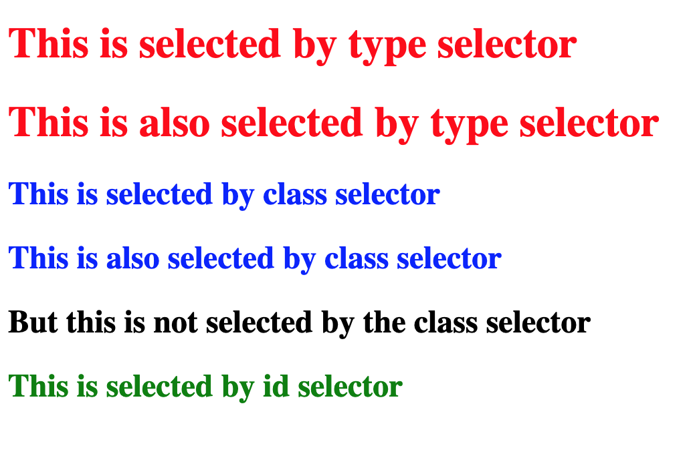
Different types of selectors
h1 {
color: red;
}
.blue-heading {
color: blue;
}
#heading-2 {
color: green;
}

Slide 15
IDs and Classes
#id
Each element can have only one ID
Each page can have only one element with a given ID
.class
You can use the same class on multiple elements.
You can use multiple classes on the same element.
VS
<ol>
<li id="id-1">Coffee</li>
<li id="id-2">Tea</li>
<li id="id-3">Milk</li>
</ol>
<h2 class=”section-text”>Section 1</h2>
<p>This is section 1</p>
<h2 class=”section-text”>Section 2</h2>
<p>This is section 2</p>
<p class=”blue-text grey-background”>This is section 1</p>

Slide 16
Cascading Style Sheets
Why “cascading”?
The term ‘Cascading’ refers to the order in which different styles are applied by the browser.
When different styles apply to the same element, there has to be a way of determining which rule wins over the others.
The rule is chosen by cascading down from more general to the more specific.
The most specific rule will be the one applied.
Inline styles have the highest specificity but avoid using them as they are not best practise. You can learn more about them in the extra slides.
Cascade
Specificity
Examples in HTML
Least specific
Elements and attributes <h2>Section 1</h2>
Classes <h2 class=”section”>Section 1</h2>
IDs <h2 id=”section1”>Section 1</h2>
Inline styles <h2 style=”color: blue;”>Section 1</h2>
Most specific

Slide 17
Cascading Style Sheets
CSS file: #specificColor {
color: brown;
}
.color {
font-size: 30px;
}
.color1 {
color: blue;
}
.color2 {
color: #ac2399
}
.color3 {
color: rgb(27,125,48);
}
Quiz time
What colour would the word ‘Style’ be?
Welcome to wonderful world of Cascading Style Sheets
<h4>Welcome to the wonderful world of
<span class="color color1">Cascading </span>
<span class="color color2" id="specificColor">Style </span>
<span class="color color3">Sheets</span>
</h4>

Slide 18
Cascading Style Sheets
CSS file: #specificColor {
color: brown;
}
.color {
font-size: 30px;
}
.color1 {
color: blue;
}
.color2 {
color: #ac2399
}
.color3 {
color: rgb(27,125,48);
}
Quiz time
What colour would the word ‘Style’ be?
Welcome to wonderful world of Cascading Style Sheets
<h4>Welcome to the wonderful world of
<span class="color color1">Cascading </span>
<span class="color color2" id="specificColor">Style </span>
<span class="color color3">Sheets</span>
</h4>
Welcome to wonderful world of Cascading Style Sheets

Slide 19
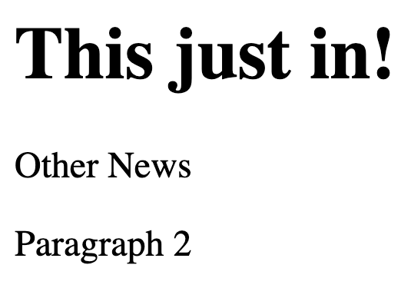
Cascading Style Sheets
Quiz time
Which part of the text will be blue?
div {
background-color: red;
}
.news {
background-color: green;
}
.news p {
background-color: yellow;
}
.news .other {
background-color: blue;
}
<div class="news">
<h1 class="headline">This just in!</h1>
<p class="other">Other News</p>
<p>Paragraph 2</p>
</div>

Slide 20
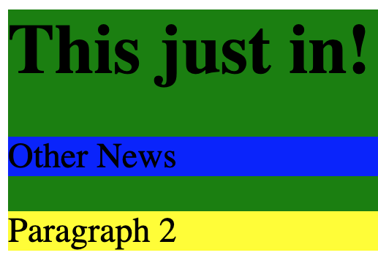
Cascading Style Sheets
Quiz time
Which part of the text will be blue?
div {
background-color: red;
}
.news {
background-color: green;
}
.news p {
background-color: yellow;
}
.news .other {
background-color: blue;
}
<div class="news">
<h1 class="headline">This just in!</h1>
<p class="other">Other News</p>
<p>Paragraph 2</p>
</div>

Slide 21
Exercises
Navigate to the BBC’s homepage
Open the developer tools* *Right click on a headline on the page, and click inspect from the dropdown
You should see the headline inside a HTML tag. Change the colour of this headline to be red.
To undo any changes refresh the page
Try and change the navigation to have a red background with white text

Slide 22
Session 2 Recap
Throughout this session you learnt about:
What is CSS?
Anatomy of a CSS rule
Linking your CSS to HTML
Common properties
Different types of selectors
Cascading styles

Slide 23
Additional exercises
Style the other two pages that we created last week. These should:
Use the same styling that we already have on the home page (consistency is key!).
Include extra styles to make your elements even nicer

Slide 24
Attribute selector
Attribute selector will select an element based on the presence or value of a given attribute.
CSS file:
h1 [title] {
color: green;
}
HTML file:
<h1 title=”Home”>Welcome to my site!</h1>
Welcome to my site!
h1[title=”Home”] {
background: lightgrey;
}
For more complicated ways to match a value, e.g. the title value starting with “A..”, have a look at the documentation here:
https://developer.mozilla.org/en-US/docs/Web/CSS/Attribute_selectors

Slide 25
Combinators
Descendant selector
A descendant selector allows us to select all elements that are descendants of another element
HTML file:
<p>A long time ago...</p>
<div class= ”starwars”>
<p>In a galaxy far, far away</p>
</div>
CSS file:
p {
color: blue;
}
.starwars p {
color: red
}
A long time ago…
In a galaxy far, far away
For more examples and types of combinators have a look at the documentations here: https://developer.mozilla.org/en-US/docs/Learn/CSS/Building_blocks/Selectors/Combinators

Slide 26
Hierarchy of CSS imports
It is possible to link multiple style sheets on the same web page.
In the example below, two stylesheets are linked in the index.html page.
The second stylesheet will inherit the styles from the first, and override where there are any conflicts.
HTML file:
<head>
<title>StylesDemo</title>
<link rel="stylesheet" href="stylesheet1.css">
<link rel="stylesheet" href="stylesheet2.css">
</head>
<body>
<h1>Main Title</h1>
</body>
stylesheet1.css:
body {
background: white;
}
h1 {
color: red;
}
stylesheet2.css:
body {
background: white;
}
h1 {
color: green;
}
Main Title
Here, the <h1> style from the first style sheet is overridden by the css in second style sheet making the <h1> green.

